Slide 1

STOCK MARKET ANALYSIS

Slide 2

Stock Market Analysis Team
Meet the Team:
Gulfam
Chitti
Praveen

Slide 3

Objectives and Impacts
Objectives:
Establish a Multi-Platform Data Pipeline: To integrate fragmented stock market data from various sources into a unified SQL database, ensuring "one version of the truth" for all financial reporting.
Evaluate Strategy Precision: To measure the effectiveness of trading decisions using advanced metrics like the 89% Win Rate and the 1.16 Sharpe Ratio.
Maximize Stakeholder Visibility: To create interactive dashboards in Excel, Tableau, and Power BI that allow for real-time tracking of portfolio health across different countries (India/USA) and sectors.

Slide 4

Objectives and Impacts
Impacts:
Clear Quantified Performance Success: Successfully identified and tracked a Total Realized Profit of $61M and a 27% ROI, providing clear evidence of the portfolio's growth.
Optimized Resource Allocation: Pinpointed that Information Technology ($20M profit) and Financials ($16M profit) are our strongest drivers, allowing the firm to double down on high-performing sectors.
Operational Transparency: Achieved a 100% Order Execution Rate and identified our Top 5 Traders (led by Morgan Williams with $5M profit), creating a culture of accountability and excellence.

Slide 5

Stock Market Analytics KPI INFOGRAPHICS
Total Realized P&L : Actual cash profit.$61M
Sharpe Ratio : Risk vs. reward 1.16
Trade Win Rate : Strategy accuracy rate 89%
Order Execution Rate : System reliability/speed 100%
Total Trade Volume : Market activity scale 221M
Trade Win Rate : Confirms 89% of trades hit profit targets.

Slide 6

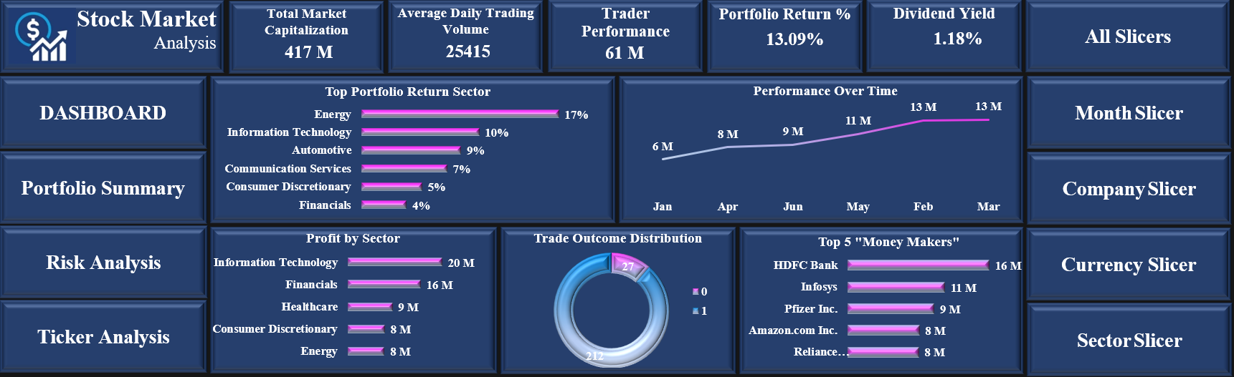
EXCEL DASHBOARD 1

Slide 7

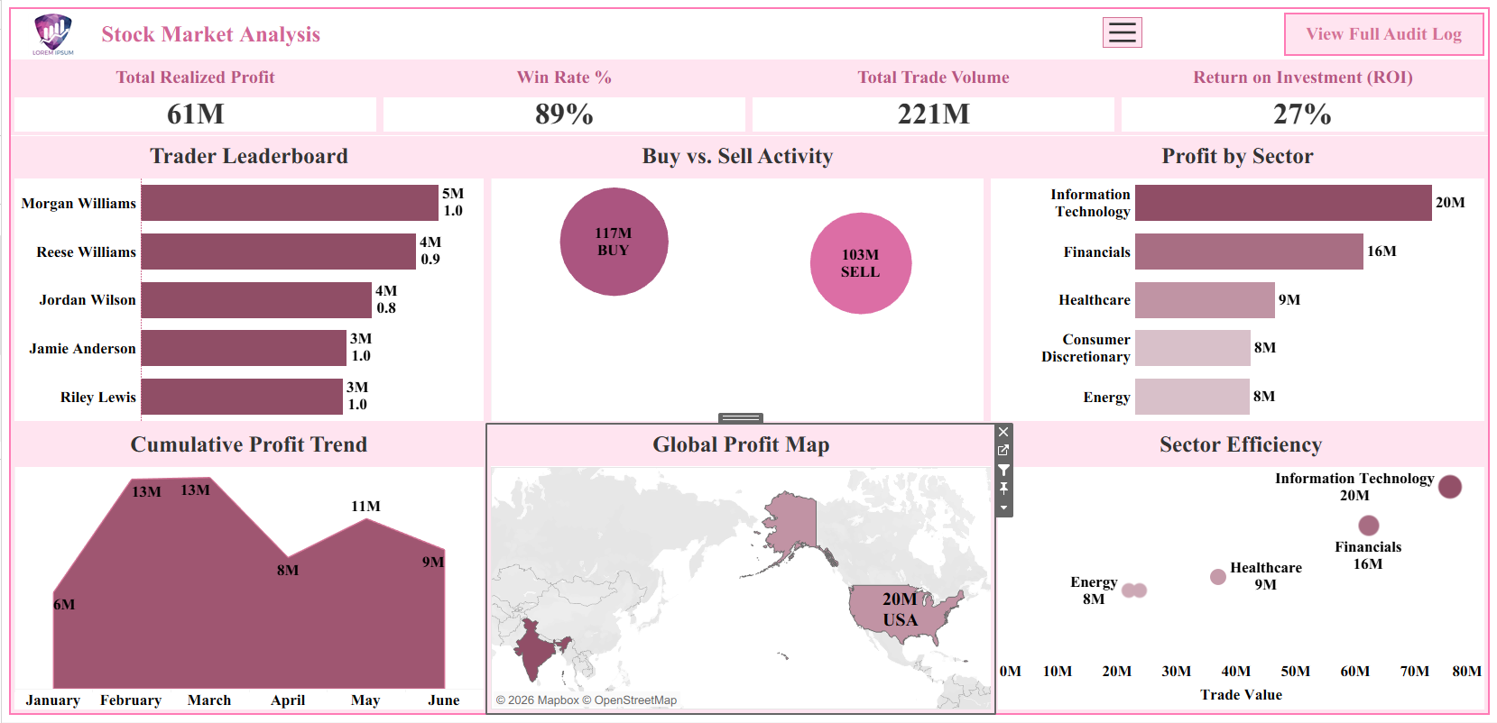
TABLEAU DASHBOARD 1

Slide 8
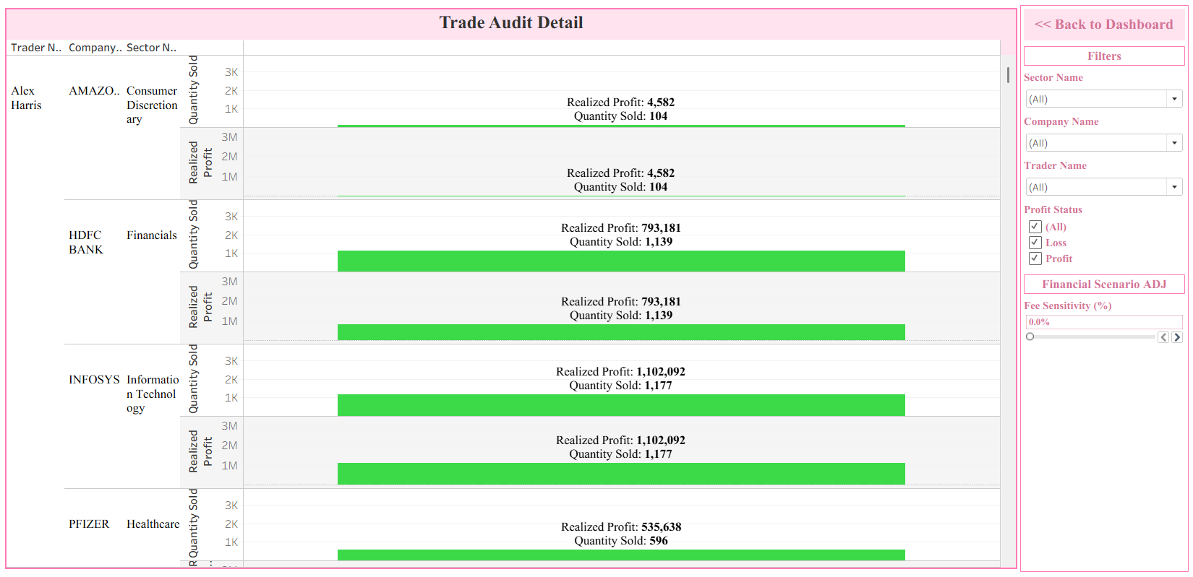
TABLEAU DASHBOARD 2

Slide 9

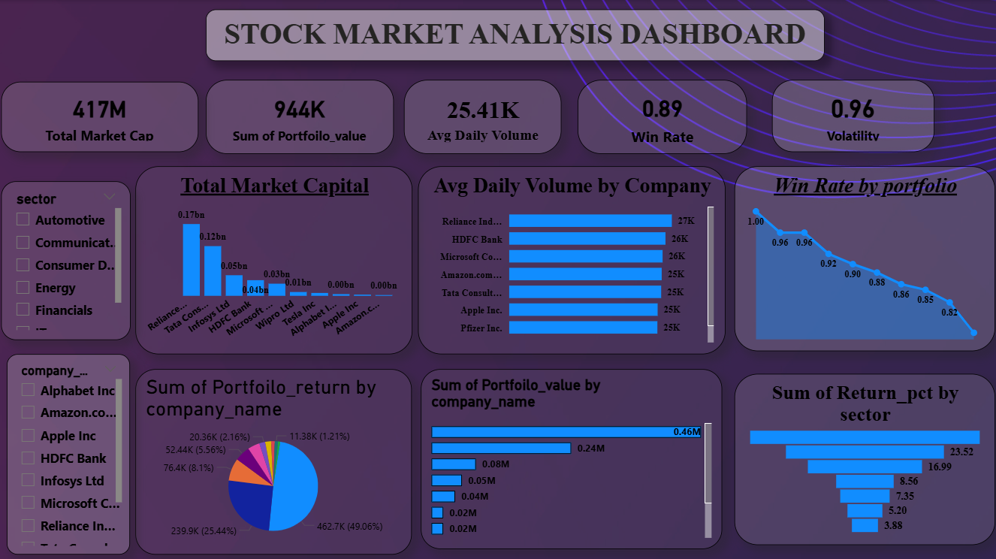
POWER BI DASHBOARD 1

Slide 10
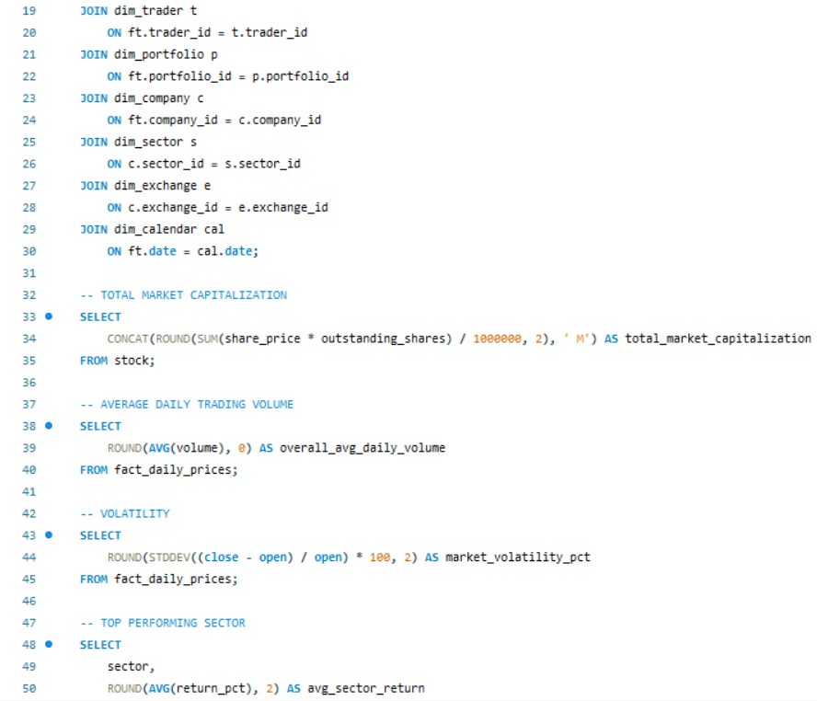
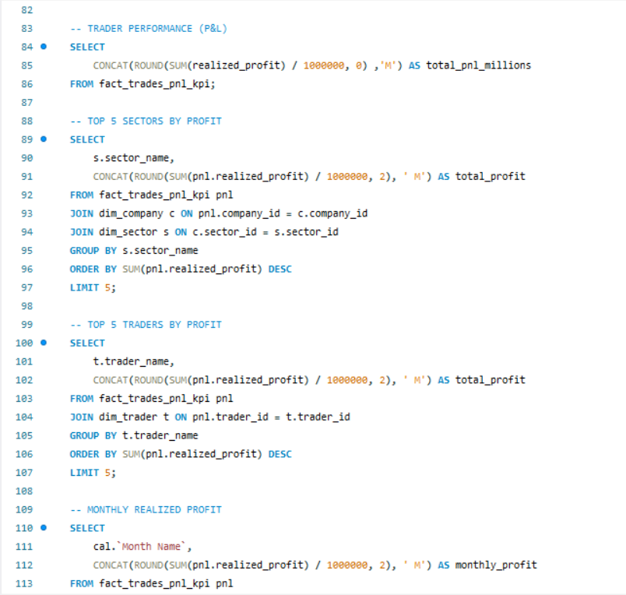
SQL Queries

Slide 11

Analytical Highlights
Strategy Precision: Achieved an elite 89% Win Rate with a healthy 1.16 Sharpe Ratio.
Sector Performance: Identified Information Technology and Financials as our primary profit drivers.
Geographic Success: Confirmed the USA market as our highest volume contributor to the $61M profit.
Operational Peak: Maintained a 100% Execution Rate, ensuring no missed trade opportunities.

Slide 12

Bottlenecks
Inactive clients lowering account activity ratio
Market Volatility: Managing portfolio risk during periods of high price instability.
Data Integration: Cleaning and merging fragmented datasets from different global markets.
Scalability: Maintaining high win-rate precision as the total portfolio value grows.

Slide 13

Strategic Suggestions
Capital Weighting: Increase investment in our top-performing tech and finance sectors.
Global Expansion: Diversify into new markets to reduce regional economic risk.
Real-time Analytics: Automate SQL monitoring for live tracking of risk-adjusted returns.
Performance Benchmarking: Use Top 5 Trader data to optimize team-wide trading strategies.

Slide 14


